Slide 1
Topic: Volume Introduction
EQ: How do we convert volume units?
Ms. Latham

Slide 2
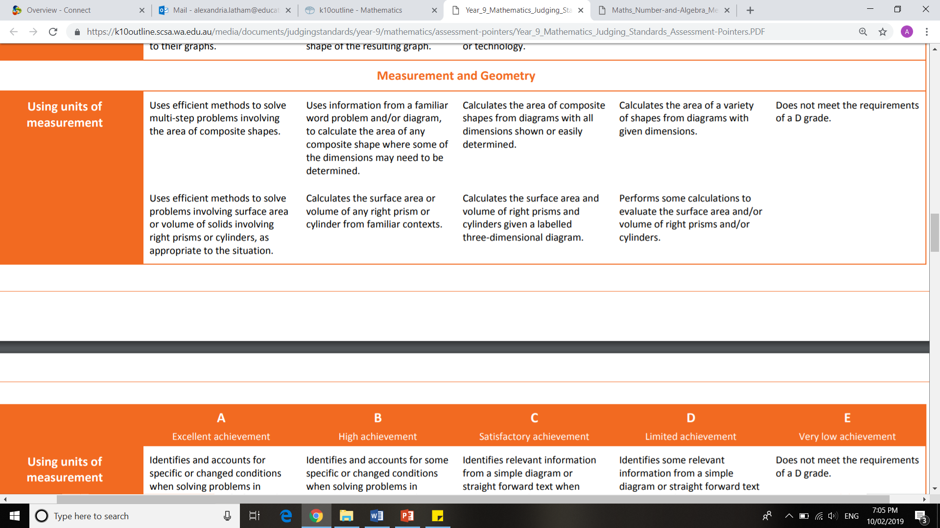
Judging Standards

Slide 3
Topic: Volume Introduction
EQ: How do we convert volume units?
What is volume?
3-D measurement
The amount of space that an object occupies or is held within a container
Volume consists of CUBED units (3-D) so we need to CUBE all of normal length conversions
Volume Units
Example
3 m³ = __ cm³
We need to multiply it by 100³ or
3×100×100 ×100
3,000,000 cm³

Slide 4
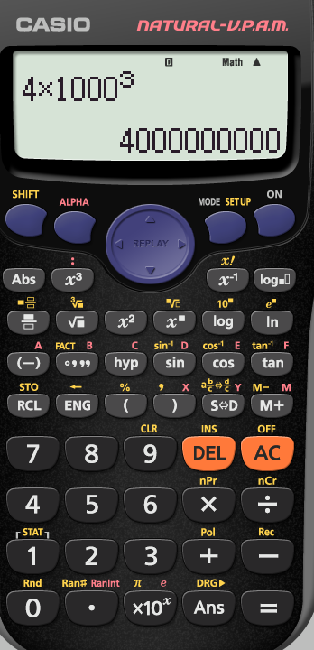
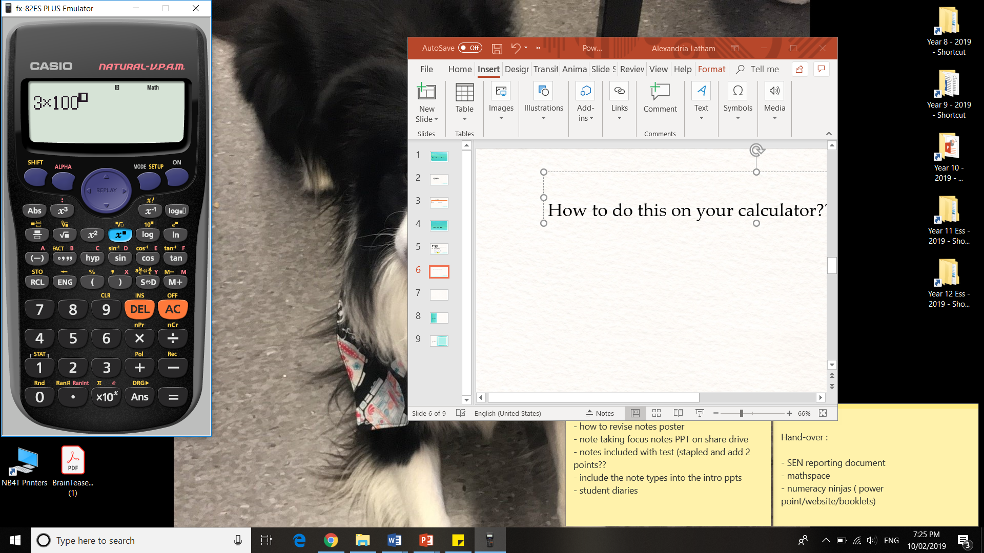
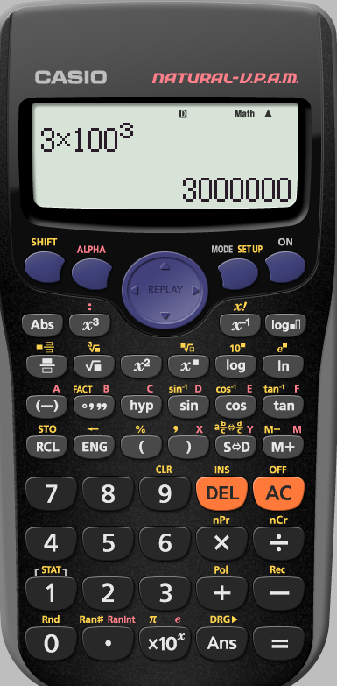
How to do this on your calculator??
Your turn to practice on the calculator.
4 × 1000³ =
Which will make a little box appear in the index location of 100
To raise a number, in this case 100, to any power you need to first type in the number and then press this button
Then you can type whichever index (exponent/power) you need. For volume units we will use a 3.

Slide 5
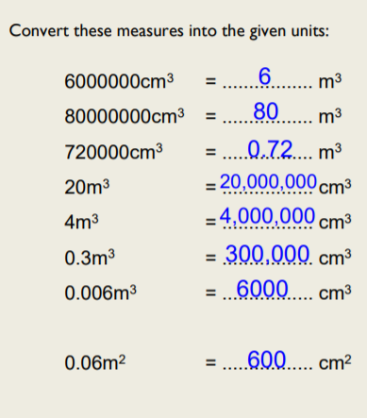
Practice Time!! – On your LHS

Slide 6
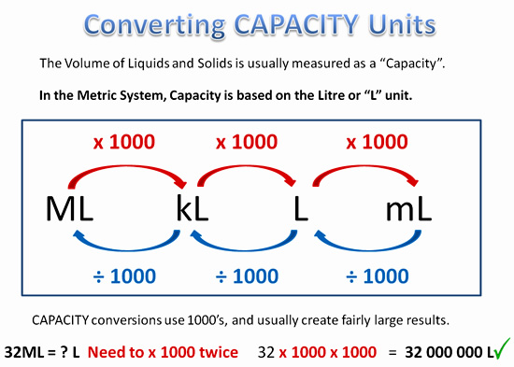
Topic: Volume Introduction
EQ: How do we convert volume units?
What is capacity?
The amount of liquid that can fit into a space, based on the L ‘litre’ unit
Capacity units
Example
325 mL to L
We need to divide by 1000
0.325 L

Slide 7
Practice Time!! – On your LHS

